Slide 1

Predicting Manhattan Crime Using Naive Bayes Classifier
Capstone Project

Slide 2
Introduction
A crime can happen anytime and anywhere without any warning. Sometimes, it can happen at the same place and at the same recurring time. I think it would be great if we can predict where and when the crime is going to be and we can prevent it before it happened. By using artificial intelligence and machine learning from historical data, we could build a classifier to make a prediction out of it. So in this project I will try to train a model using naive bayes classification algorithm to predict a crime that is going to happen around Manhattan on January 2020. Naive bayes is a classification algorithm that using a concept of likelihood a posterior event may happened after a prior event. Hopefully, someone will be interested on this matter of research and conduct any further research using more powerful algorithm and state of the art method. It will be very helpful for the law enforcer to handle the crime in the area.

Slide 3
Data Description
nyu-geojson data to retrieve the neighborhood latitude and longitude
Foursquare API to retrieve the venues around the neighborhood
NYPD complaint data on year range from 2015 – 2019

Slide 4
methodology
Retrieve venues data from Foursquare API
Preprocess NYPD complaints data (clean data type, resample data, split train test data)
Training model
Evaluate model
Make a prediction

Slide 5
result
Accuracy : 0.4958 %
F1 score : 0.3333 %

Slide 6
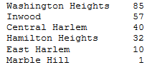
prediction
225 total crime of INTOXICATED/IMPAIRED DRIVING is going to happen on January 5th around these neighborhood:

Slide 7
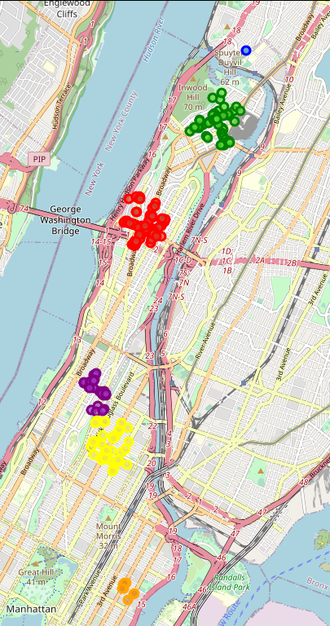
Predicted crime map
Blue : Marble Hill
Green : Inwood
Red : Washington Heights
Purple : Hamilton Heights
Yellow : East Harlem
Orange : Central Harlem

Slide 8
Conclusion
Naive bayes classifier can make a model that can predict a crime in Manhattan but the model itself is still need a lot of more improvement to increase the accuracy of model.
Further research : improve the model performance, use another algorithm, add more features that correspond the happening of a crime from another source of data

